Slide 1
IP Security
have a range of application specific security mechanisms
  eg. S/MIME, PGP, Kerberos, SSL/HTTPS
however there are security concerns that cut across protocol layers
would like security implemented by the network for all applications
Notes:
The Internet community has developed application-specific security mechanisms in a number of application areas, including electronic mail (S/MIME, PGP), client/server (Kerberos), Web access (Secure Sockets Layer), and others. However users have some security concerns that cut across protocol layers. By implementing security at the IP level, an organization can ensure secure networking not only for applications that have security mechanisms but also for the many security-ignorant applications.

Slide 2
IP Security
general IP Security mechanisms
provides
  authentication
  confidentiality
  key management
applicable to use over LANs, across public & private WANs, & for the Internet
need identified in 1994 report
  need authentication, encryption in IPv4 & IPv6
Notes:
IP-level security encompasses three functional areas: authentication, confidentiality, and key management. The authentication mechanism assures that a received packet was transmitted by the party identified as the source in the packet header, and that the packet has not been altered in transit. The confidentiality facility enables communicating nodes to encrypt messages to prevent eavesdropping by third parties. The key management facility is concerned with the secure exchange of keys. IPSec provides the capability to secure communications across a LAN, across private and public WANs, and across the Internet.
In 1994, the Internet Architecture Board (IAB) issued a report titled "Security in the Internet Architecture" (RFC 1636). The report stated the general consensus that the Internet needs more and better security and identified key areas for security mechanisms. To provide security, the IAB included authentication and encryption as necessary security features in the next-generation IP, which has been issued as IPv6. Fortunately, these security capabilities were designed to be usable both with the current IPv4 and the future IPv6.

Slide 3
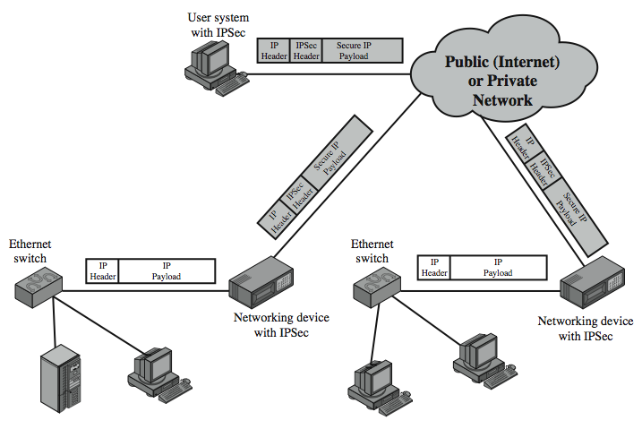
IP Security Uses
Notes:
Stallings Figure 19.1 illustrates a typical IP Security scenario. An organization maintains LANs at dispersed locations. Nonsecure IP traffic is conducted on each LAN. For traffic offsite, through some sort of private or public WAN, IPSec protocols are used. These protocols operate in networking devices, such as a router or firewall, that connect each LAN to the outside world. The IPSec networking device will typically encrypt and compress all traffic going into the WAN, and decrypt and decompress traffic coming from the WAN; these operations are transparent to workstations and servers on the LAN. Secure transmission is also possible with individual users who dial into the WAN. Such user workstations must implement the IPSec protocols to provide security.

Slide 4
Benefits of IPSec
in a firewall/router provides strong security to all traffic crossing the perimeter
in a firewall/router is resistant to bypass
is below transport layer, hence transparent to applications
can be transparent to end users
can provide security for individual users
secures routing architecture
Notes:
Some of the benefits of IPSec include:
• When implemented in a firewall or router, it provides strong security that can be applied to all traffic crossing the perimeter. Traffic within a company or workgroup does not incur the overhead of security-related processing.
• in a firewall is resistant to bypass if all traffic from the outside must use IP and the firewall is the only means of entrance from the Internet into the organization.
• is below the transport layer (TCP, UDP) and so is transparent to applications. There is no need to change software on a user or server system when IPsec is implemented in the firewall or router. Even if IPsec is implemented in end systems, upper-layer software, including applications, is not affected.
• can be transparent to end users. There is no need to train users on security mechanisms, issue keying material on a per-user basis, or revoke keying material when users leave the organization.
• can provide security for individual users if needed. This is useful for offsite workers and for setting up a secure virtual subnetwork within an organization for sensitive applications.
It also plays a vital role in the routing architecture required for internetworking.

Slide 5
IP Security Architecture
specification is quite complex, with groups:
  Architecture
    RFC4301 Security Architecture for Internet Protocol
  Authentication Header (AH)
    RFC4302 IP Authentication Header
  Encapsulating Security Payload (ESP)
    RFC4303 IP Encapsulating Security Payload (ESP)
  Internet Key Exchange (IKE)
    RFC4306 Internet Key Exchange (IKEv2) Protocol
  Cryptographic algorithms
  Other (security policy and management information base (MIB) content)
Notes:
The IPSec specification has become quite complex. key management. The totality of the IPsec specification is scattered across dozens of RFCs and draft IETF documents, making this the most complex and difficult to grasp of all IETF specifications. The best way to keep track of and get a handle on this body of work is to consult the latest version of the IPsec document roadmap. The documents can be categorized into the following groups:
• Architecture: Covers the general concepts, security requirements, definitions, and mechanisms defining IPsec technology, see RFC 4301, Security Architecture for the Internet Protocol.
• Authentication Header (AH): AH is an extension header for message authentication, now deprecated. See RFC 4302, IP Authentication Header.
• Encapsulating Security Payload (ESP): ESP consists of an encapsulating header and trailer used to provide encryption or combined encryption/authentication. See RFC 4303, IP Encapsulating Security Payload (ESP).
• Internet Key Exchange (IKE): a collection of documents describing the key management schemes for use with IPsec. See RFC4306, Internet Key Exchange (IKEv2) Protocol, and other related RFCs.
• Cryptographic algorithms: a large set of documents that define and describe cryptographic algorithms for encryption, message authentication, pseudorandom functions (PRFs), and cryptographic key exchange.
• Other: There are a variety of other IPsec-related RFCs, including those dealing with security policy and management information base (MIB) content.

Slide 6
IPSec Services
Access control
Connectionless integrity
Data origin authentication
Rejection of replayed packets
  a form of partial sequence integrity
Confidentiality (encryption)
Limited traffic flow confidentiality
Notes:
IPSec provides security services at the IP layer by enabling a system to select required security protocols, determine the algorithm(s) to use for the service(s), and put in place any cryptographic keys required to provide the requested services. Two protocols are used to provide security: an authentication protocol designated by the header of the protocol, Authentication Header (AH); and a combined encryption/authentication protocol designated by the format of the packet for that protocol, Encapsulating Security Payload (ESP). RFC 4301 lists the security services supported as shown above.

Slide 7
Transport and Tunnel Modes
Transport Mode
  to encrypt & optionally authenticate IP data
  can do traffic analysis but is efficient
  good for ESP host to host traffic
Tunnel Mode
  encrypts entire IP packet
  add new header for next hop
  no routers on way can examine inner IP header
  good for VPNs, gateway to gateway security
Notes:
Both AH and ESP support two modes of use: transport and tunnel mode, but will focus on ESP.
Transport mode provides protection primarily for upper-layer protocols. Transport mode ESP is used to encrypt and optionally authenticate the data carried by IP. Typically, transport mode is used for end-to-end communication between two hosts (e.g., a client and a server, or two workstations). When a host runs AH or ESP over IPv4, the payload is the data that normally follow the IP header. For IPv6, the payload is the data that normally follow both the IP header and any IPv6 extensions headers that are present. Transport mode operation provides confidentiality for any application that uses it, thus avoiding the need to implement confidentiality in every individual application.
Tunnel mode ESP is used to encrypt an entire IP packet. To achieve this, after the AH or ESP fields are added to the IP packet, the entire packet plus security fields is treated as the payload of new "outer" IP packet with a new outer IP header. The entire original, or inner, packet travels through a "tunnel" from one point of an IP network to another; no routers along the way are able to examine the inner IP header. Tunnel mode is useful in a configuration that includes a firewall or other sort of security gateway that protects a trusted network from external networks. In this latter case, encryption occurs only between an external host and the security gateway or between two security gateways. With tunnel mode, a number of hosts on networks behind firewalls may engage in secure communications without implementing IPsec.

Slide 8
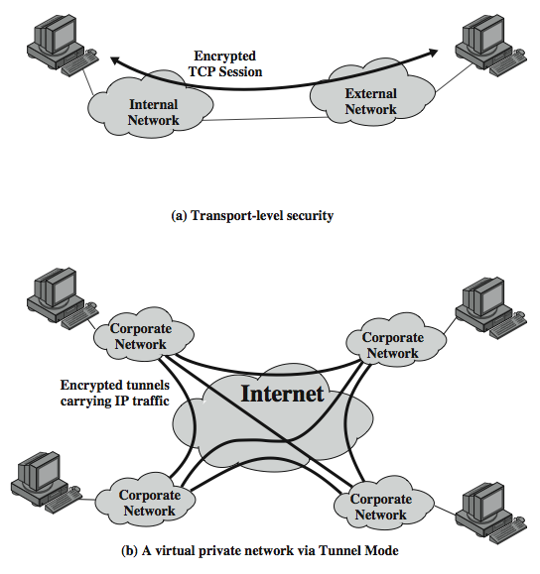
Transport and
Tunnel Modes
Notes:
Stallings Figure 19.7 shows two ways in which the IPsec ESP service can be used. In the upper part of the figure, encryption (and optionally authentication) is provided directly between two hosts. Figure 19.7b shows how tunnel mode operation can be used to set up a virtual private network. In this example, an organization has four private networks interconnected across the Internet. Hosts on the internal networks use the Internet for transport of data but do not interact with other Internet- based hosts. By terminating the tunnels at the security gateway to each internal network, the configuration allows the hosts to avoid implementing the security capability. The former technique is support by a transport mode SA, while the latter technique uses a tunnel mode SA.

